Slide 1
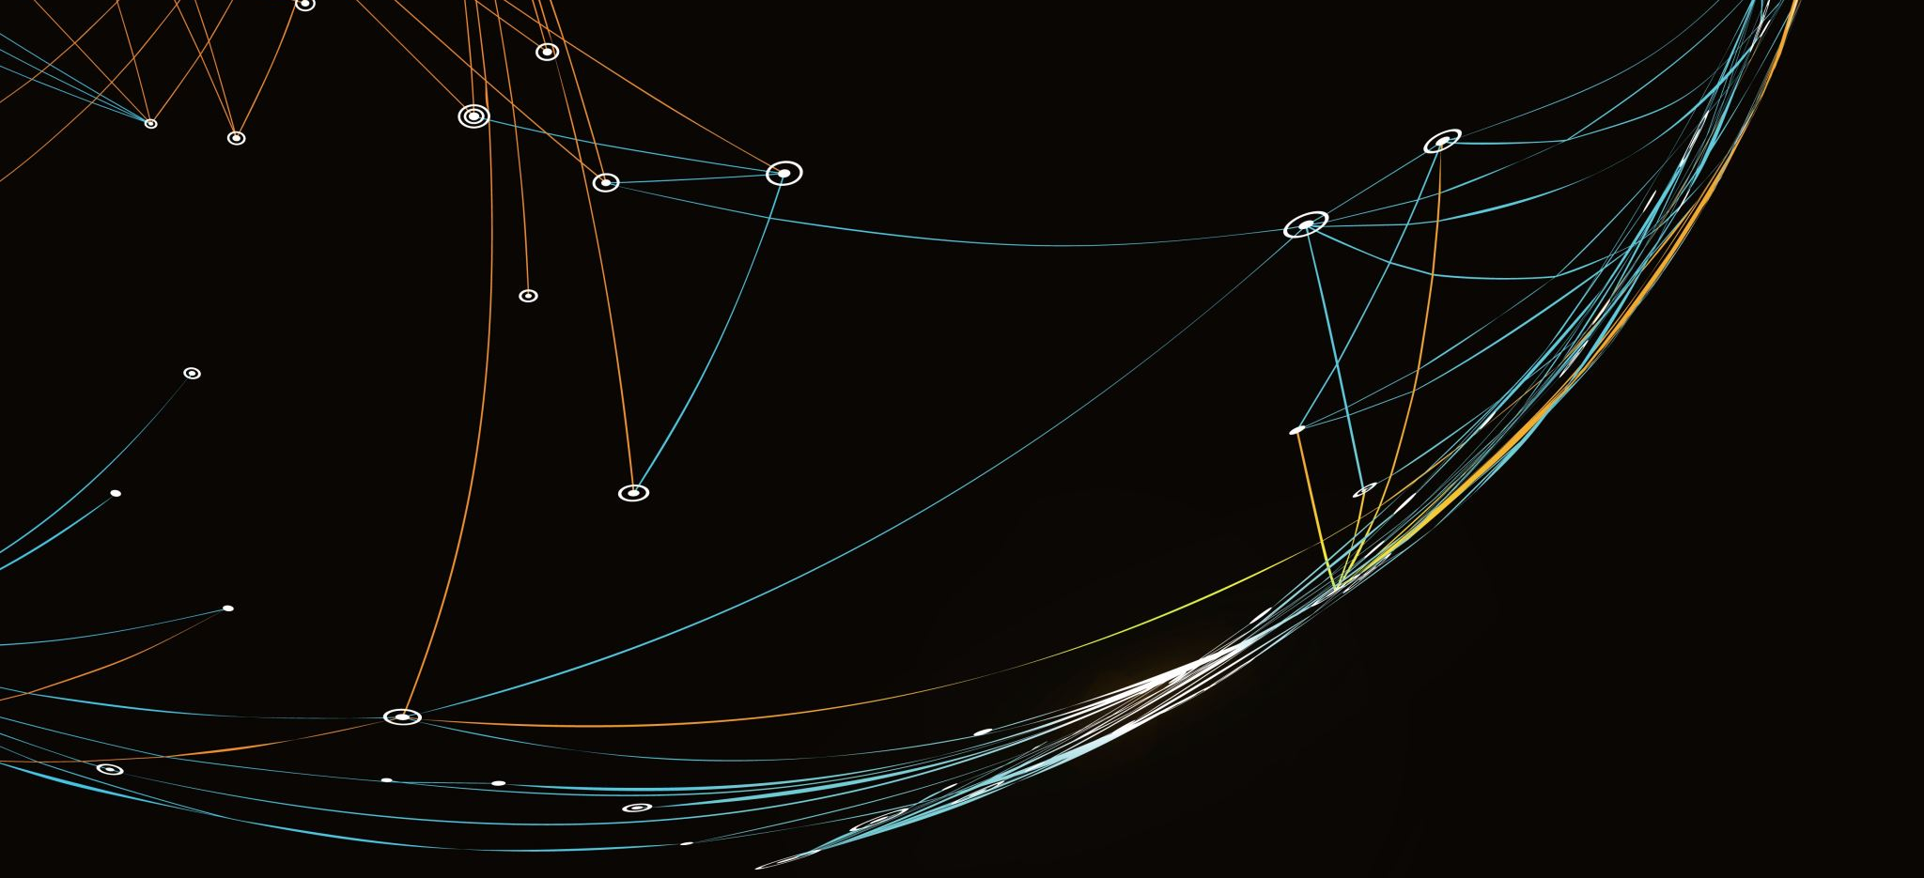
Can Synthetic Data Make Research Data More Open? Opportunities and Privacy Risks in the Age of AI
Qinyi liu
City university of Macau

Slide 2

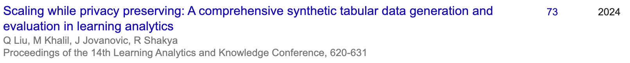
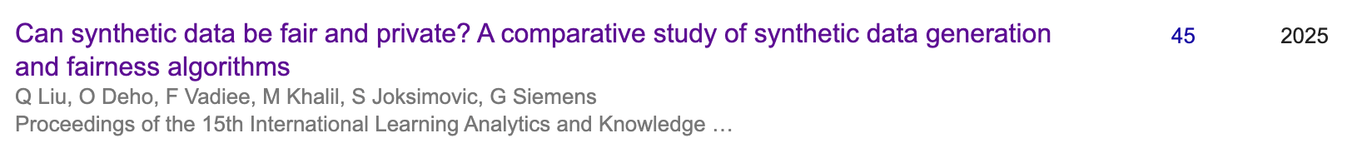
What I have been working on
Qinyi Liu, Assistant Professor at City University of Macau
Ph.D. in Centre for the Science of Learning and Technology (SLATE), University of Bergen, Norway
My PhD is about using privacy-enhancing techniques like synthetic data generation to address privacy issues in datasets
See more here! Website: qinyiliu.site

Slide 3

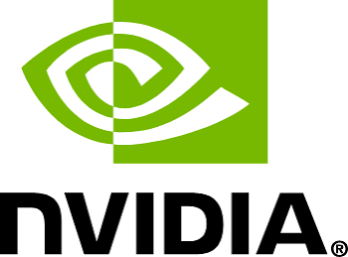
Huge attention has been given to synthetic data
"Right now we have exhausted practically the entirety of human knowledge for training AI... The only way to augment real-world information is synthetic data.” —— Elon Musk
"Today, human-generated knowledge is 99%. In 10 years, it will probably be 1%. The vast majority of knowledge will be generated by AI—it's going to be synthetic generated intelligence.” —— Jensen Huang

Slide 4

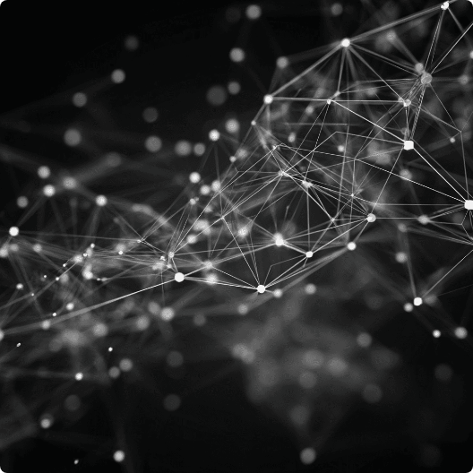

THE OPEN SCIENCE DREAM
You collected the perfect dataset.
Rich, longitudinal patient histories.
High statistical power.
Ready for global collaboration.

Slide 5
But you cannot share it.
Record ID:
UIO-992-8A
The Reality
Patient Age:
42 Years Old
Location:
Oslo, Norway
Direct records contain sensitive personal identifiers.
Diagnosis:
Type 2 Diabetes
Strict ethical constraints prevent raw data release.
Outcome:
Full Remission
Progress halts completely.
GDPR PRIVACY BLOCK
Notes:
Mentioned the other way it’s the same, other people has perfect dataset, but they can’t share it with you.

Slide 6


THE CURRENT IMPASSE
Two broken options.
Heavy Anonymization
The Data Silo
Locked away securely.
Information deeply aggregated.
Zero scientific reproducibility.
Destroyed analytical utility.

Slide 7


A NEW PARADIGM
What if we share the pattern, not the actual data?
Enter AI-generated synthetic data.
Statistical fidelity maintained. Privacy preserved.

Slide 8
Today’s plan
What is Synthetic data, and what opportunities can it bring?
How to generate synthetic data
How to evaluate synthetic data
One example of using synthetic data for open science
Limitation of synthetic data

Slide 9
What is synthetic data?
“Generally, synthetic data is defined as the artificially annotated information generated by computer algorithms or simulations” [1].
Synthetic data can
Cost saving
Reduce bias
Privacy protection

Slide 10
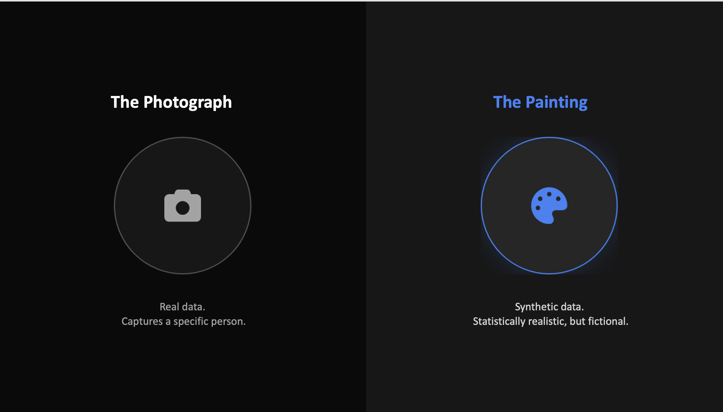
Notes:
I know 'AI-generated data' sounds like a black box. So before we get technical, I want you to keep this mental model in mind. Think of your real, raw dataset as a Photograph. A photograph captures exactly what was in front of the lens. It captures a specific, identifiable person. Synthetic data is NOT a blurry photograph. Synthetic data is a Painting. It’s created by an AI that has looked at ten thousand photographs. The AI paints a new face. It has two eyes, a nose, human skin texture—it has all the correct statistical properties of a human. But that specific person in the painting? They do not exist in the real world. We are sharing the painting, not the photo.

Slide 11





THE WORKFLOW
How this enables Open Science.
Secure Vault
AI Generation
Open Access
Original raw data remains isolated.
Model learns the statistical distributions.
Publish synthetic data openly for code-testing.
Notes:
So how does this actually look in a practical Open Science workflow? It’s not about replacing real data; it’s about creating a bridge.Step 1: Your highly sensitive, raw dataset stays exactly where it is—locked in a secure vault at the University of Oslo.Step 2: We bring an AI model into that secure environment to learn the statistical patterns—the correlations between age, diagnosis, and outcomes.Step 3: The AI outputs the synthetic 'painting'. This is the dataset you publish openly on GitHub or Zenodo. Now, researchers in Tokyo or Boston can download your synthetic data, write their Python or R scripts, test their hypotheses, and verify their code runs perfectly. If they find something promising, they can email you their finished code, and you run it on the real data in the vault. We achieve global collaboration without ever moving the sensitive data.

Slide 12
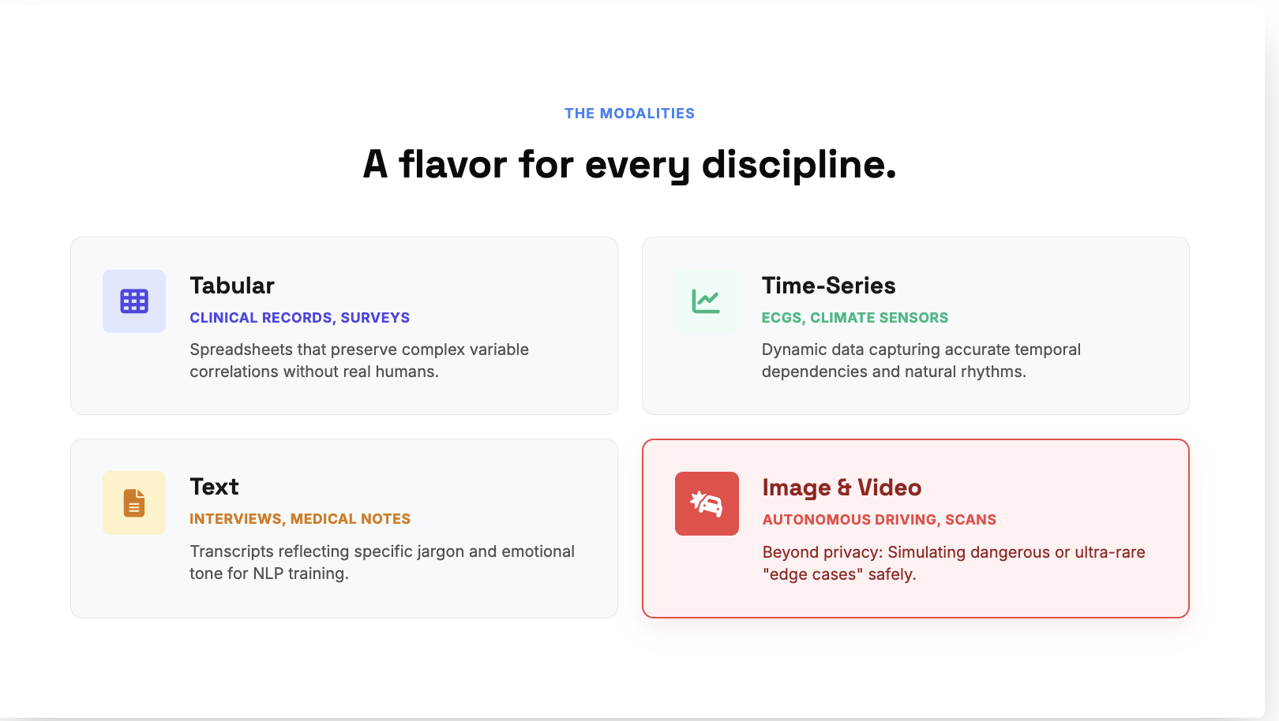
synthetic data types
Notes:
The beauty of synthetic data is that it adapts to your specific research medium. It generally falls into four main categories, and depending on your discipline, you’ll interact with different ones.
First, Tabular Data. This is the bread and butter for social scientists and epidemiologists. We are talking about spreadsheets, census data, clinical trials. You generate a synthetic CSV file that preserves all the complex correlations between variables, but contains zero real humans. You can attach this directly to your paper as supplementary material.
Second, Time-Series Data. If you study climate sensors, financial markets, or wearable tech, your data changes over time. We can synthesize dynamic trajectories, like a fake 24-hour heart rate monitor (ECG) that maintains the correct physiological rhythms.
Third, Text. For the humanities and NLP researchers. Think of doctor’s clinical notes or transcripts of sensitive interviews about mental health. We can generate synthetic transcripts that maintain the same linguistic structures and psychological markers, allowing you to share qualitative datasets without violating ethics.
And finally, Images and Video. This is huge in computer vision. It's used for privacy—like generating synthetic MRI brains—but it's also used for something else: simulating the rare and the dangerous. Take autonomous driving. If you want to train an AI to avoid a moose jumping onto an icy road in a blizzard at night, you don't want to collect that data in real life—it's too dangerous and too rare. Instead, you synthesize thousands of these 'edge cases' to train your models safely.

Slide 13
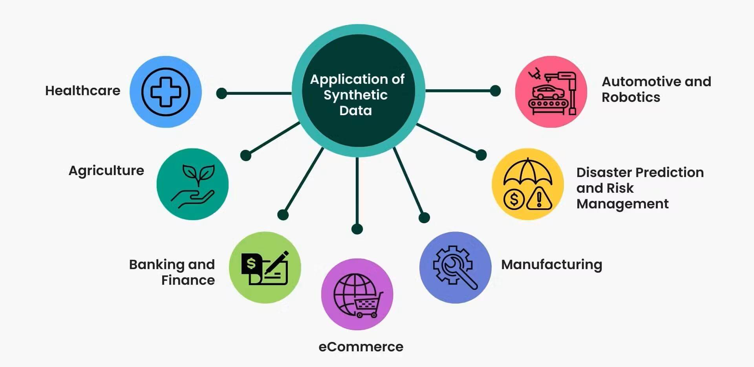
Pic sources

Slide 14
How to generate synthetic data
Statistical & Copula Models
Deep Learning: GANs, VAEs, Diffusion
LLMs & Agentic Generation

Slide 15
Statistical & Probabilistic Models
Representative algorithms: Gaussian Copulas, Bayesian Networks, Conditional Independent Models.
Working principle: Fits the marginal distribution and covariance matrix of the original data, then randomly samples from them.
Applicable scenarios: tabular data.
Advantages and disadvantages: Extremely high interpretability, extremely fast computation, and easy to prove with differential privacy; however, it cannot capture extremely complex nonlinear relationships or unstructured data.

Slide 16
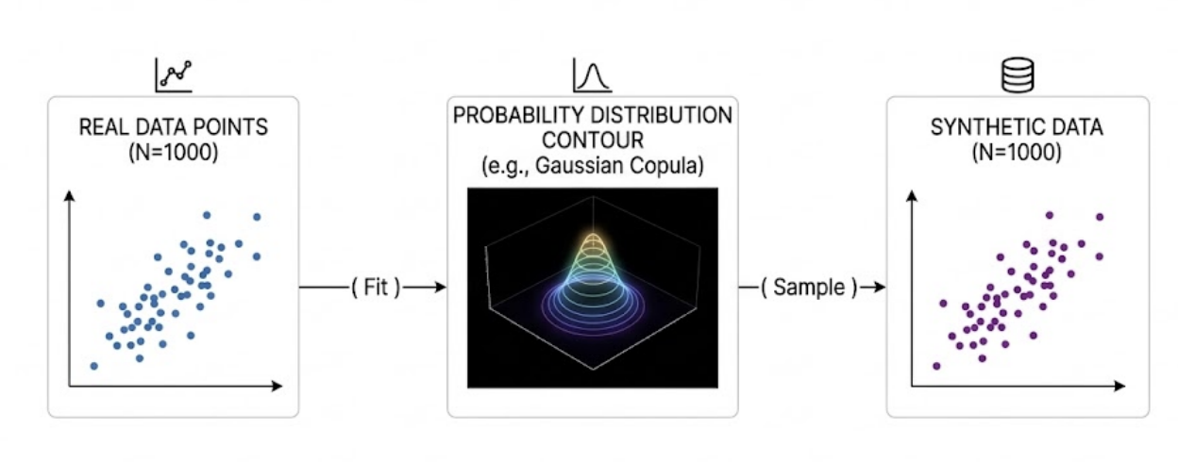
Stat methods

Slide 17
Deep Generative Models
Representative Algorithms:
GANs (Generative Adversarial Networks): such as CTGAN (for tables), TimeGAN (for time series), StyleGAN (for images).
VAEs (Variational Autoencoders): such as TVAE.
Diffusion Models: such as TabDDPM (table diffusion model), Stable Diffusion/FLUX (for images).

Slide 18
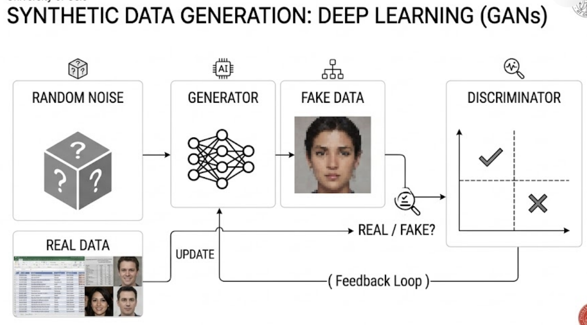

Slide 19
Deep Generative Models
Working Principle: Implicitly fits extremely complex real-world data distributions through learning the high-dimensional latent space of a neural network.
Applicable Scenarios: Complex tables, multidimensional time series, medical images, and visual data for autonomous driving.
Advantages and Disadvantages: Extremely strong fitting ability, capable of capturing deep and complex relationships; however, it requires significant computational resources and may be susceptible to mode collapse or overfitting.

Slide 20
LLM-based Synthetic Generation
Representative Methods: Prompt Engineering (Few-shot example generation), Agentic Workflows, Self-Instruct.
Working Principle: Leveraging the powerful world knowledge and contextual understanding capabilities of LLM, data is directly "written" based on the Prompt or Agent interaction logic.

Slide 21
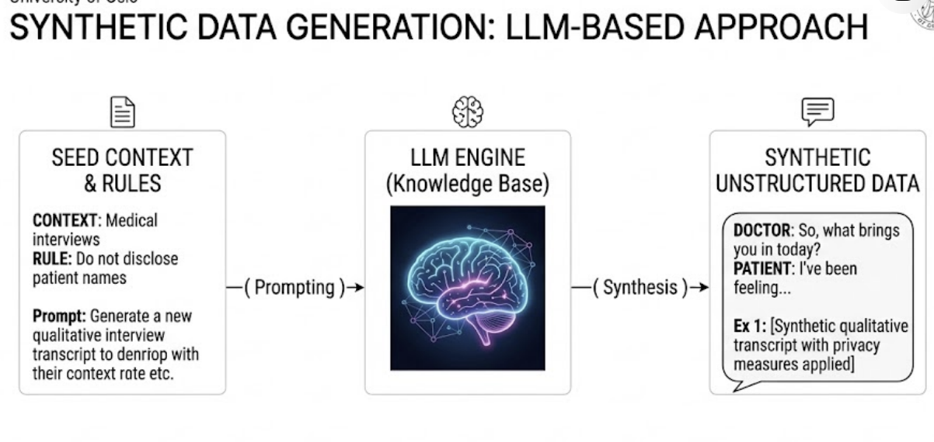

Slide 22
four main paradigms of llm synthetic data generation
In context seed generation
Agentic Persona Simulation
Structured Schema Generation
Model Distillation & Synthetic Reasoning Chains
Notes:
First, Seed-based Generation, where we provide an LLM with a few anonymized clinical notes, and it writes thousands of new, grammatically rich, yet completely artificial patient stories. Second, Agentic Persona Simulation, where we program agents with distinct demographic backgrounds to simulate qualitative interviews. Third, Schema-constrained Synthesis, forcing models to output structured JSON with natural language fields. And fourth, Model Distillation, using frontier models to synthesize reasoning datasets for training smaller, open-source local LLMs like Llama 3.

Slide 23
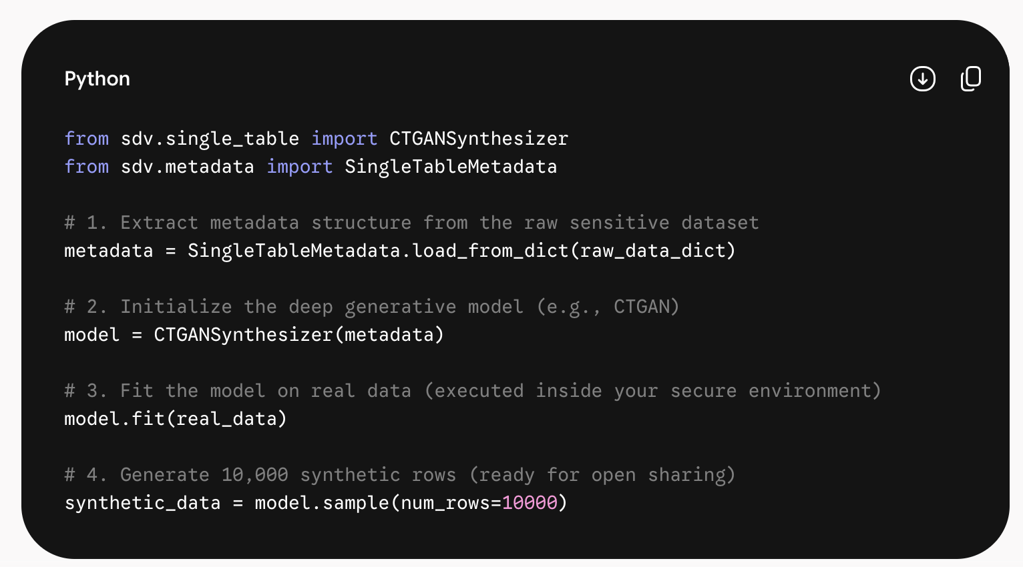
If you know some coding
Just 5- 8 rows, bang!
Notes:
Researchers with programming experience (such as Python/R users) can overcome their fear of the AI ​​barrier with just 5-8 lines of extremely concise code.

Slide 24
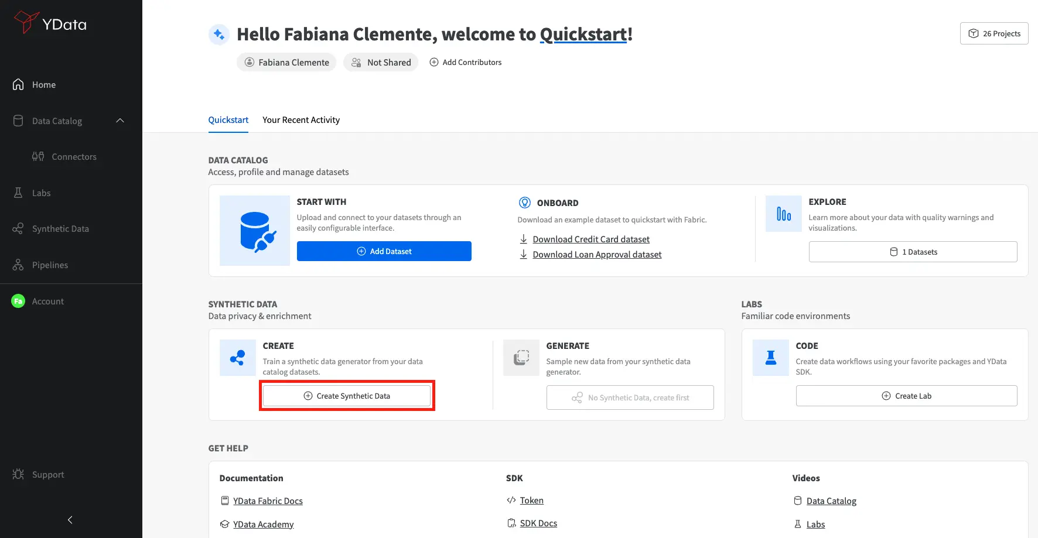
If you don’t have coding experience

Slide 25
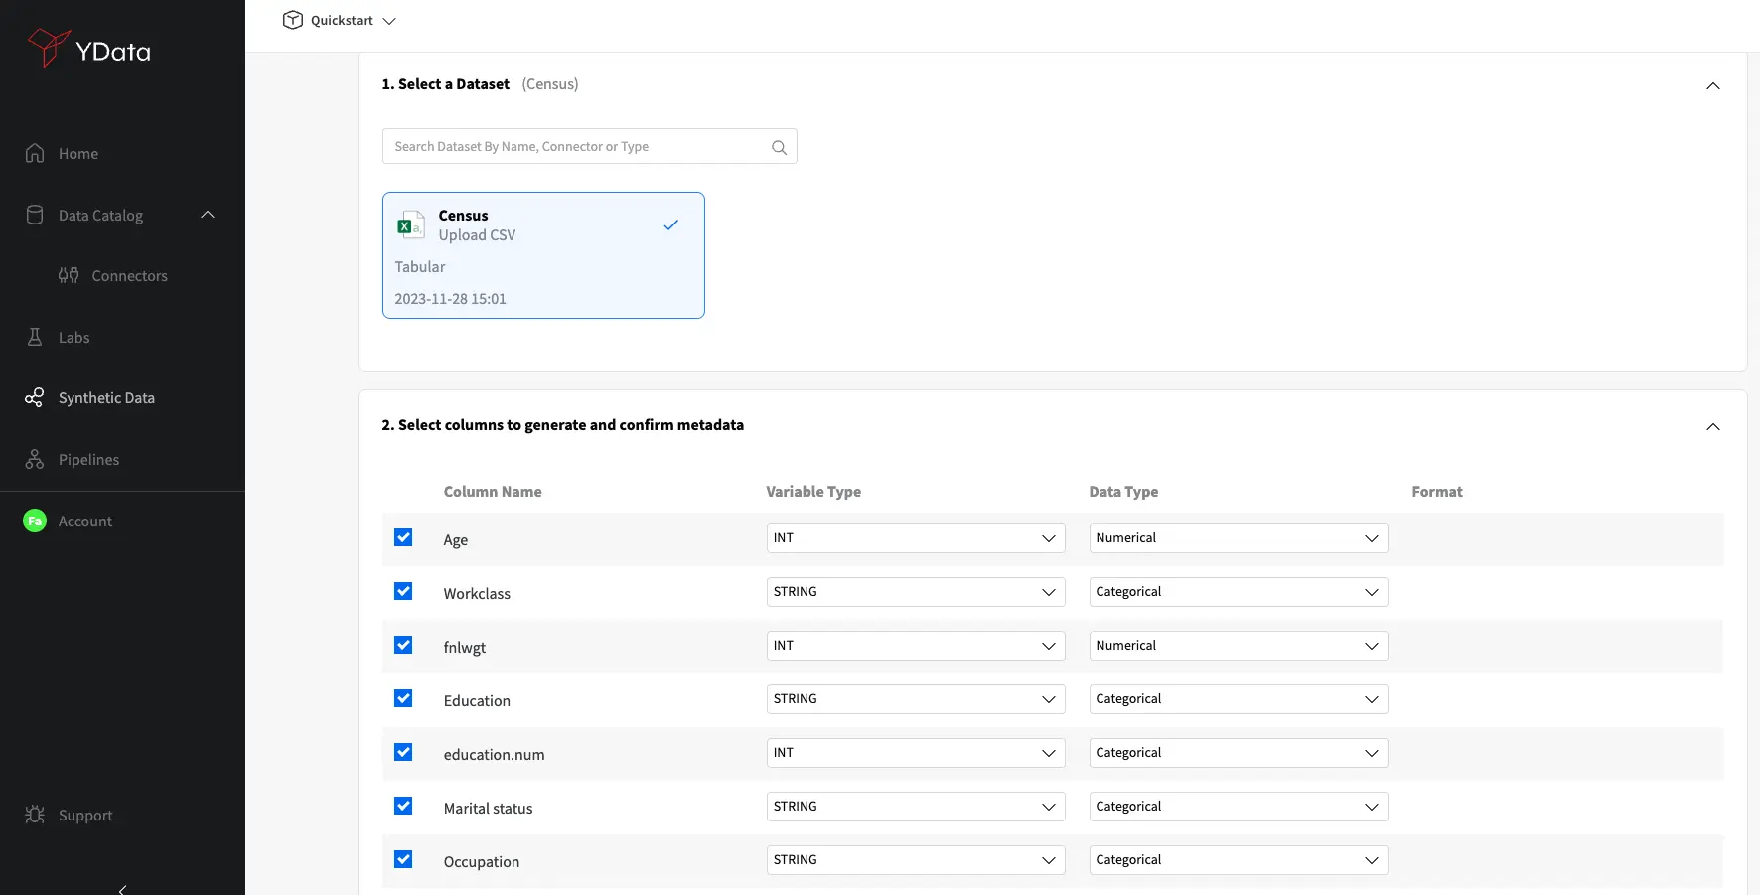
If you don’t have coding expeirence

Slide 26
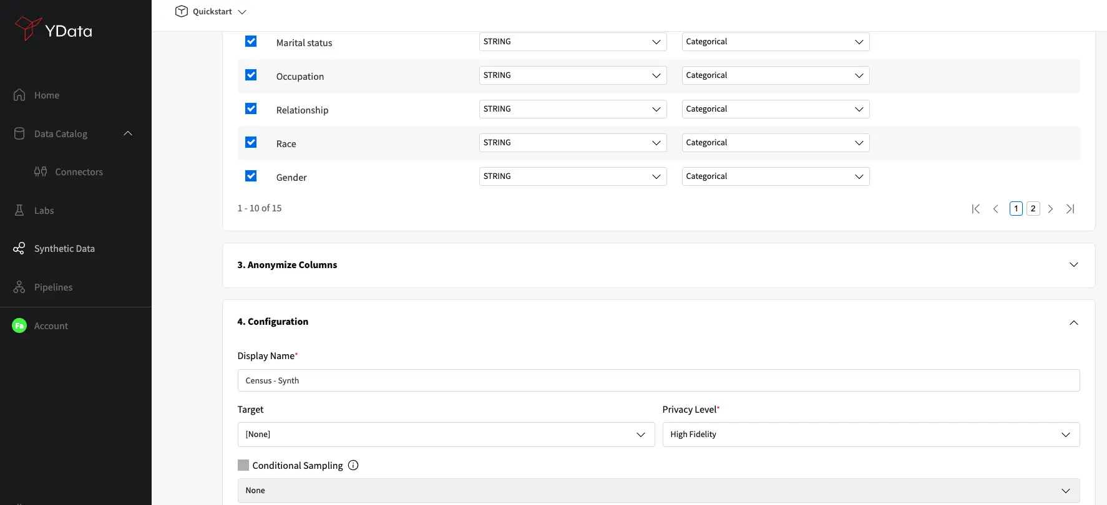

Slide 27
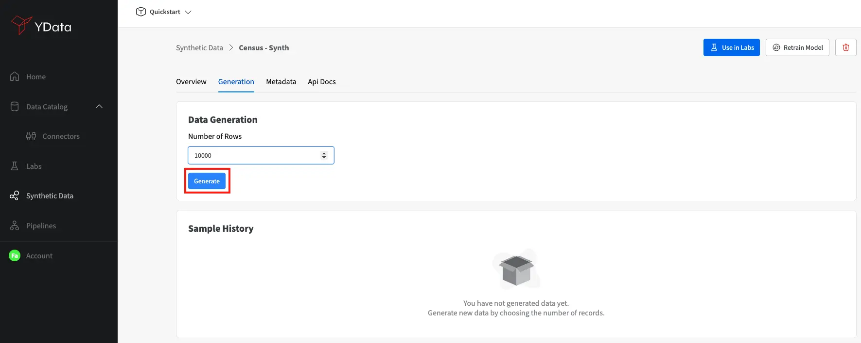

Slide 28
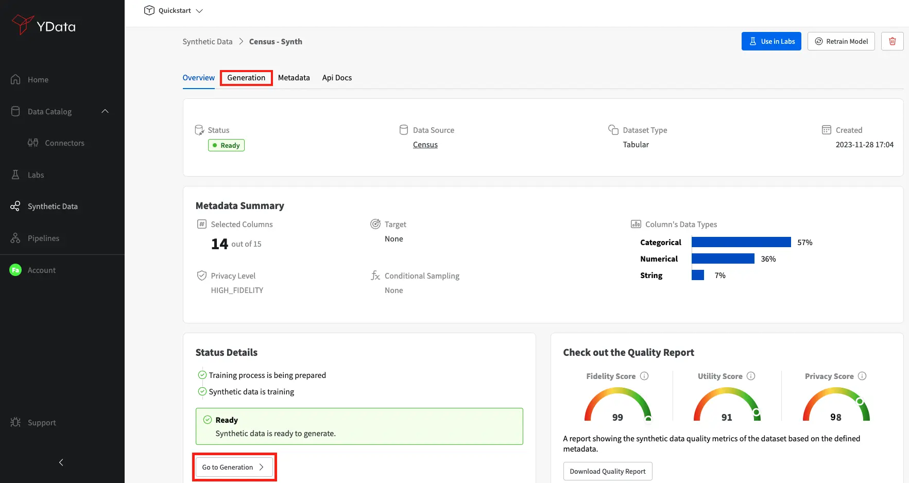
If you don’t know how to coding

Slide 29
Synthetic data evaluation
Evaluation of synthetic data
structural similarity to the original data (resemblance)
its usage for analysis and predictive modeling (utility)
protection of information stored in the real data (privacy)

Slide 30
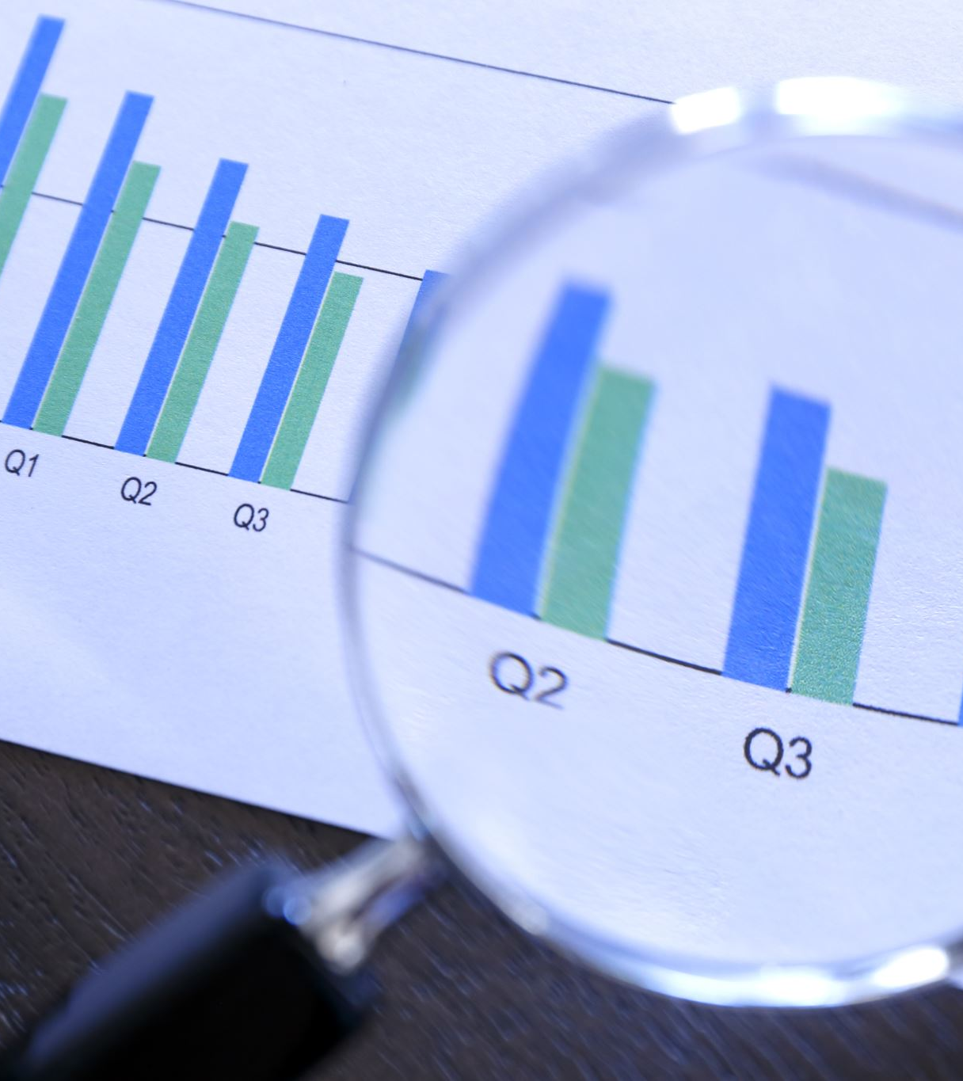
Fidelity (resemblance or similarity)
The core question: "Does the synthetic data resemble real data in appearance and distribution?"
Tabular Data: Examine the probability distribution of univariate data (e.g., KS-Test/Kolmogorov-Smirnov test) and the correlation heatmap of multivariate data.
Image Data: Examine the FID (Fréchet Inception Distance). This is the gold standard for image synthesis; the lower the FID score, the closer the feature distribution of the synthetic image is to that of a real photograph.

Slide 31
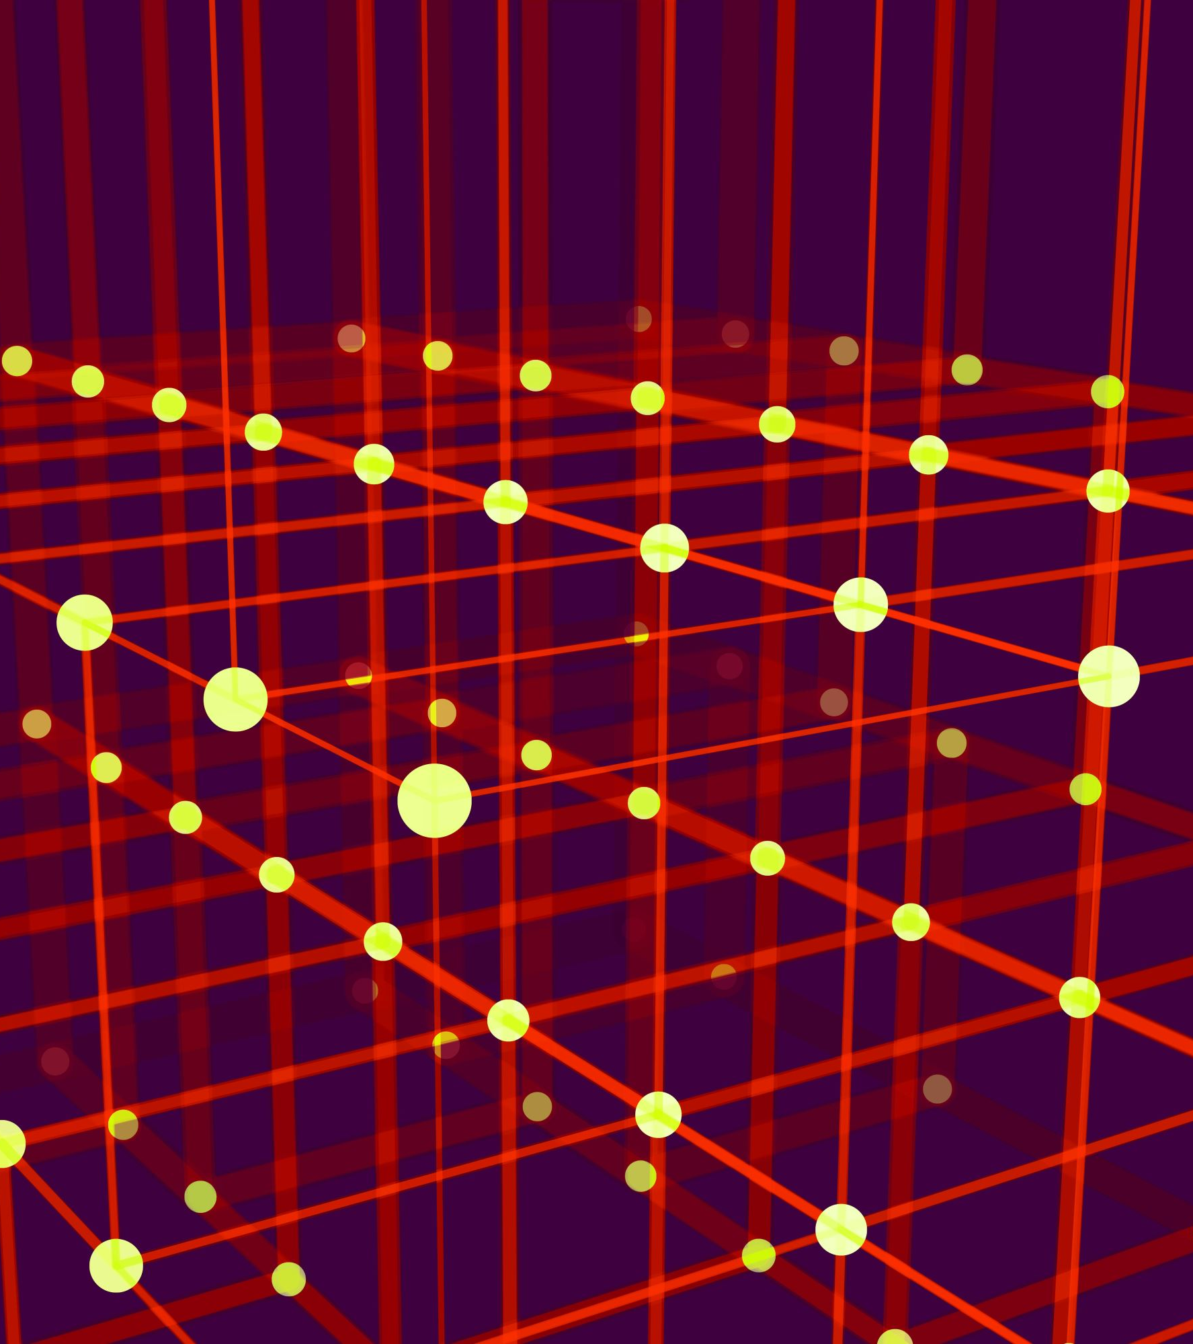
Fidelity (resemblance or similarity)
Text Data: Examine the perplexity and the degree of overlap of the embeddings (semantic vectors) in high-dimensional space.
Time-Series Data: Examine the autocorrelation function and dynamic time warping (DTW).
Notes:
1. Perplexity
Measures the "surprise" a language model has of text.
A lower value indicates a better ability to predict the next word, resulting in more fluent and natural-sounding text.
In other words, low perplexity equals a less confused model and more natural, fluent language.
2. Embedding Overlap in High-Dimensional Space
After converting text into semantic vectors (Embeddings), this measure compares the vector distribution of the generated text with that of the original text.
Higher overlap indicates a closer semantic relationship and more "reliable" generated content.
Common metrics include the text version of FID and MMD.
In short:
Perplexity measures "how fluent and natural the language is," while embedding overlap measures "how authentic the meaning is."

Slide 32
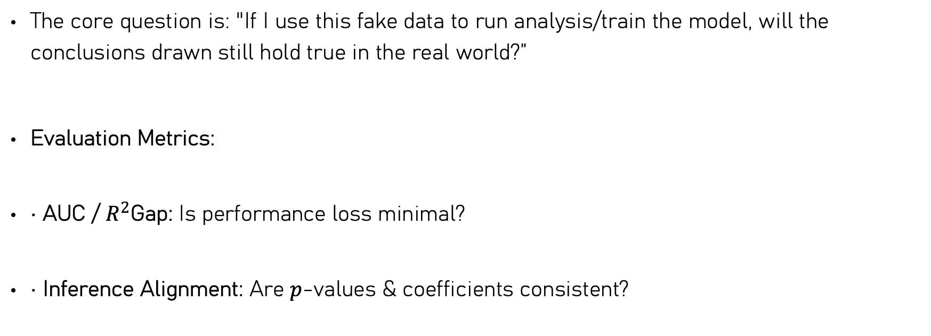
Utility
The core question is: "If I use this fake data to run analysis/train the model, will the conclusions drawn still hold true in the real world?”
Evaluation Metrics:
• AUC / $R^{2}$Gap: Is performance loss minimal?
• Inference Alignment: Are $p$-values & coefficients consistent?

Slide 33
utility
[ Benchmark: TRTR ]
Real Training Data ──> Train ML/Stats Model ──> Test on Real Data ──> Score A (e.g., AUC = 0.88)
[ Utility Test: TSTR ]
Synthetic Data ──> Train ML/Stats Model ──> Test on Real Data ──> Score B (e.g., AUC = 0.86)
Notes:
There are also cases synthetic data’s utility is higher, mostly because data argumentation

Slide 34
Privacy
Distance-based privacy: "Did the model 'memorize' a specific real subject, leading to a privacy leak?”
Attack-based privacy: Is the synthetic data model or released synthetic data robust? Let’s do some attacks and try them out

Slide 35
Specific metrics
DCR (Distance to Closest Record): Measures how far each synthetic data point is from its nearest original real data point. A distance of 0 indicates that the model is "copying" the original data, posing a serious vulnerability.
MIA (Membership Inference Attack): Simulates an attacker attempting to infer whether a specific patient is present in the original dataset using synthetic data.

Slide 36
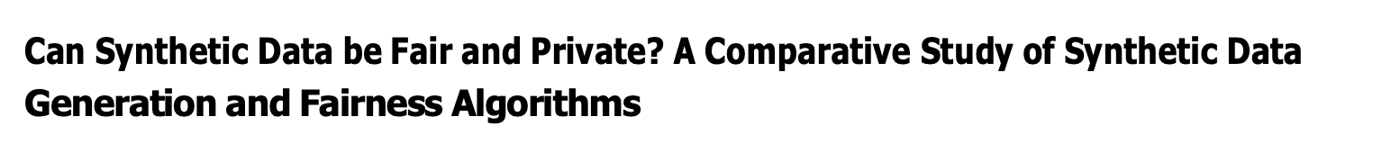
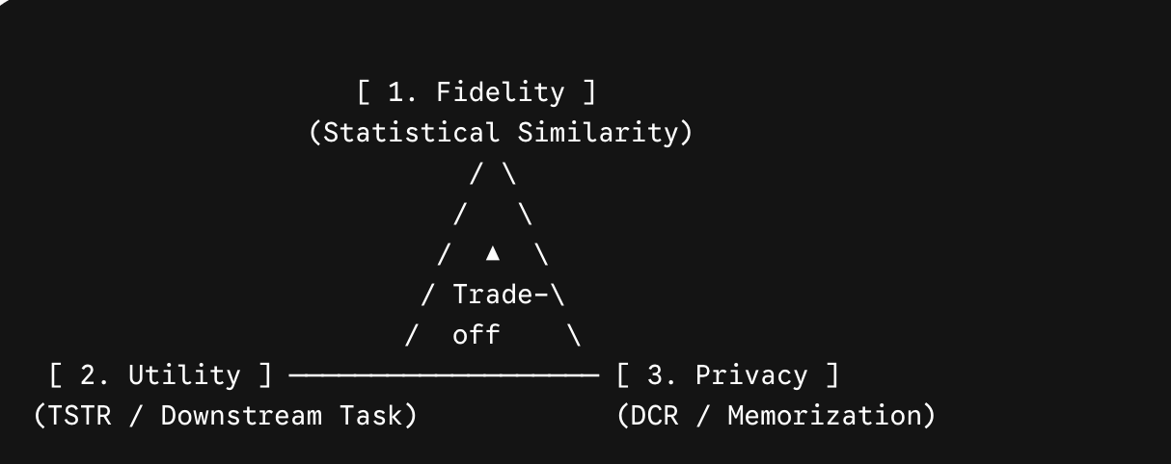
The Evaluation Triangle
There can be more: such as fairness!
Liu et al., 2025

Slide 37
Speaking of privacy in synthetic data
What if AI-generated data accidentally leaks information about a patient?
What if the data is scattered across 5 different hospitals/institutions, and none of them can send the data to the others?

Slide 38
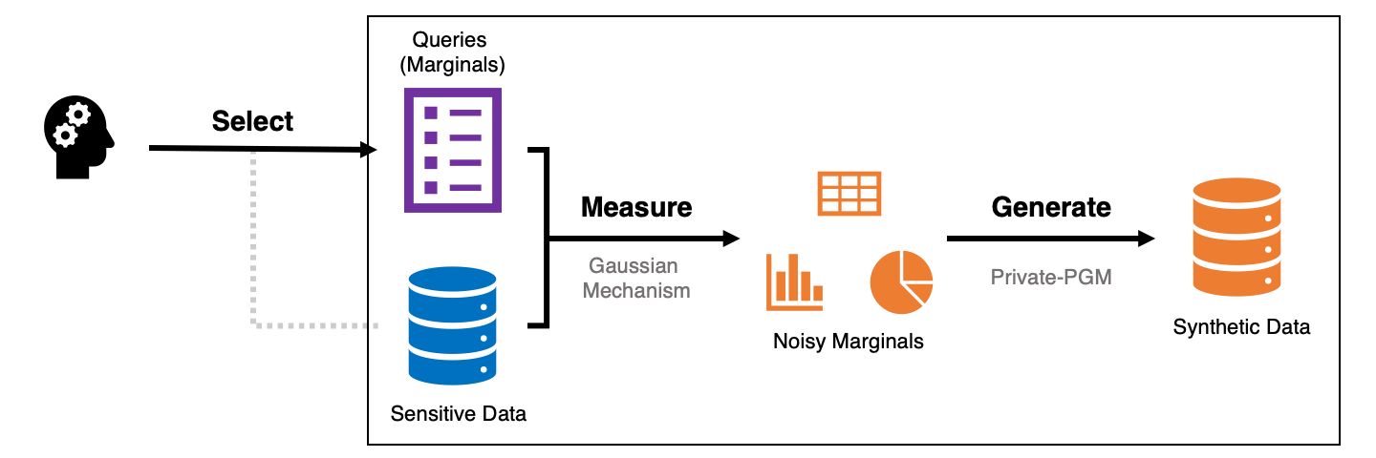
Differential private synthetic data
Pic sources
By latest AI attacks, with only synthetic data alone, it’s not safe

Slide 39
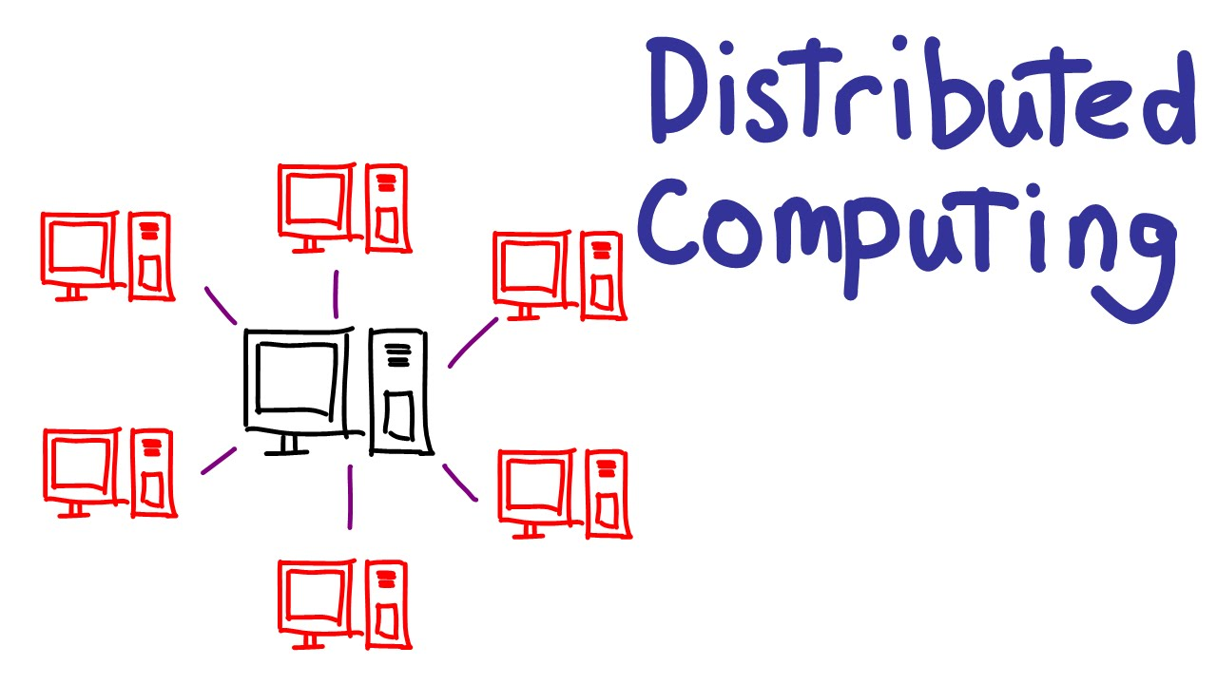
Federated Learning + Synthetic Data
The core challenge: Data is scattered across three hospitals in Oslo, USA, and London. Due to GDPR restrictions, none of the three hospitals can aggregate the raw data onto a central server.
In short: "Bring the model to the data, not the data to the model."

Slide 40
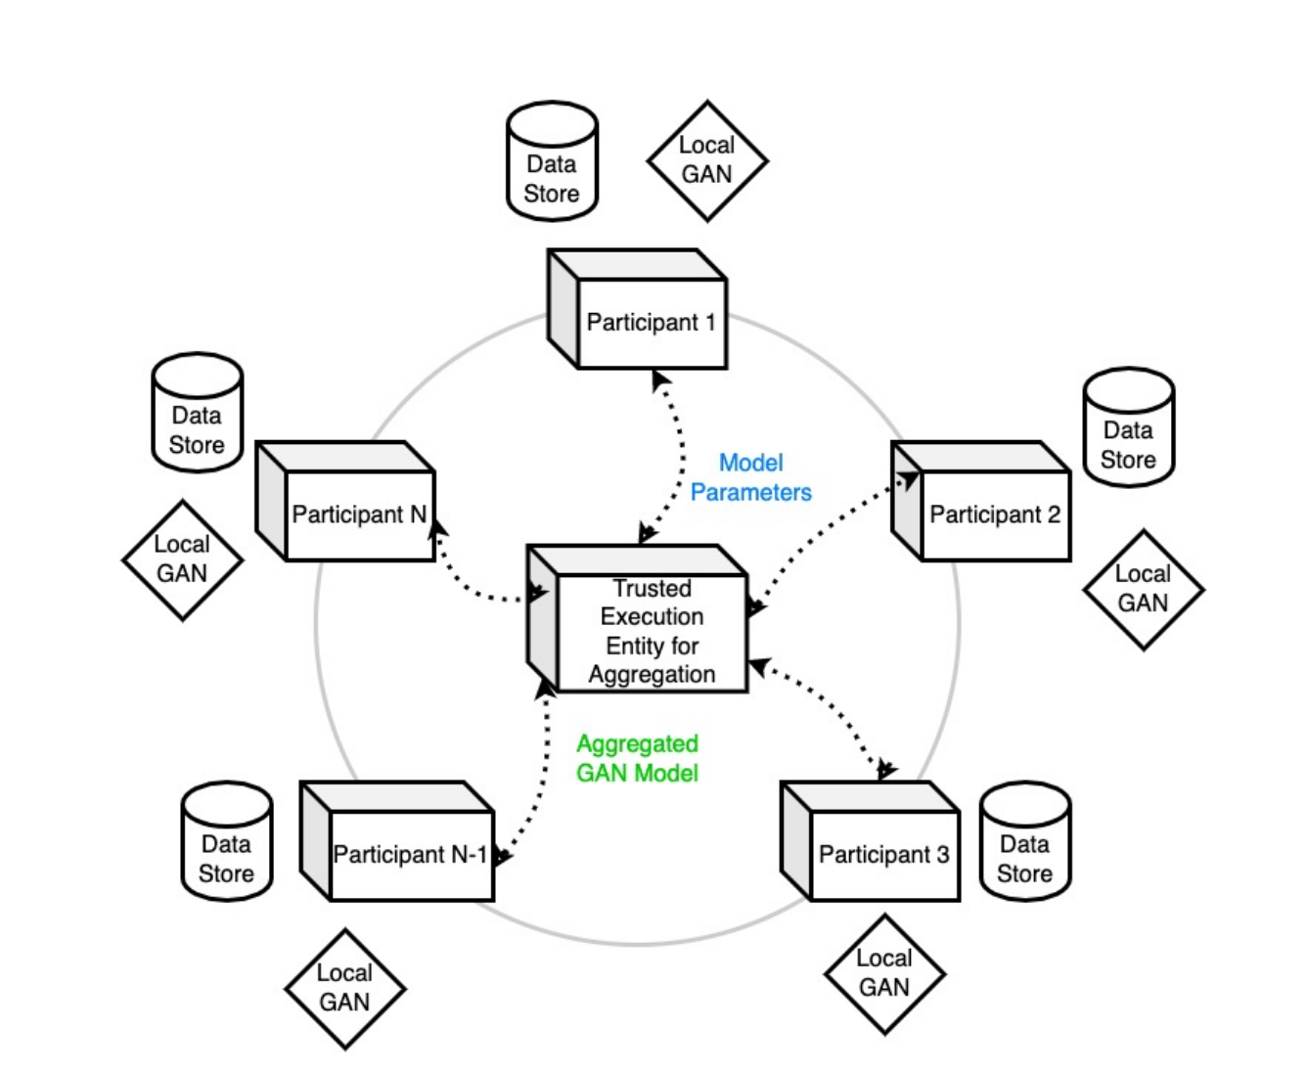
Federated Learning + Synthetic Data
The three hospitals do not share a single line of raw data. We train the AI ​​generation models locally separately and upload only the model’s ‘weight parameters’ to a central server for aggregation.
Finally, we use this ‘joint society’s AI’ to generate a global synthetic data set (Global Synthetic Dataset) that combines the strengths of each company. "

Slide 41
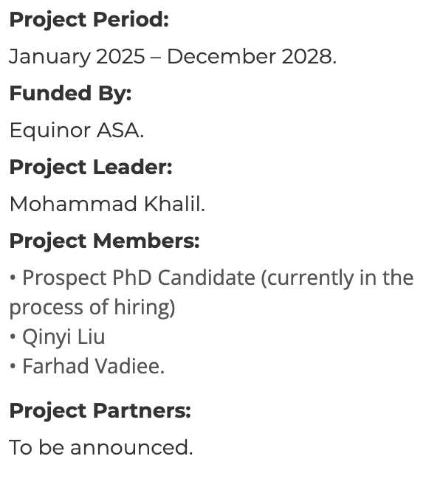
ASPIRE project in uib
Accelerating Privacy and Data Protection Measures Using Synthetic Data Generation (ASPIRE)
ASPIRE aims to develop novel synthetic data generation methods that robustly ensure privacy and data protection using two innovative techniques: Differential Privacy and Federated Learning.
For education data and health data both

Slide 42
Illustrative example: a privacy-conscious sharing workflow
1. THE DILEMMA ] | [ 3. THE OPEN SCIENCE IMPACT ]
• 5,000 sensitive patient records (EHR) | Public synthetic dataset released on Zenodo
• Locked under strict GDPR & TSD security rules | Global collaborators built & debugged algorithms without ever accessing raw patient rows
• Direct cross-border sharing was strictly impossible
[ 2. THE SYNTHETIC PIPELINE ] | [ 4. THE VALIDATION RESULT ]
• Trained CTGAN generator inside secure vault | • High Utility: TSTR Model AUC 0.85 (vs Real 0.87)
• Outputted 10,000 privacy-safe synthetic rows | • Strong Privacy: Zero leaks (DCR safety score)
• Applied strict Differential Privacy (DP) checks | • Limitation: Rare gene interactions were smoothed

Slide 43
Limitations of synthetic data
Not Automatically Anonymous – overfitting problem
Garbage In, Garbage Out & Amplified Biases
Information Loss & The "Ground Truth" Limit
Hallucination - LLM

Slide 44
Take away: practical rule for synthetic data in open science
1. Before you generate | 2. Before you share | Before you reuse
Define the target modality & complexity before picking a model | Run the evaluation test (fidelity, utility, privacy) | Use as a “sandbox”: develop code & test hypotheses safely
Don’t over-engineer: start with simple models | See if more audits are needed | Check the performance reports (if there are)
Document the generation parameters transparently for reproducibility | Report and limitations: rare samples loss

Slide 45
Useful links
Common synthetic data generation packages (if you have coding experience):
https://github.com/statice/awesome-synthetic-data
https://github.com/ql909/awesome-synthetic-data-education
https://github.com/Data-Centric-AI-Community/fg-data-synthetic
https://github.com/vanderschaarlab/synthcity
https://github.com/sdv-dev/sdv
Common synthetic data generation dashboard (if you don’t know how to coding)
https://docs.synthetic.ydata.ai/latest/ydata_fabric_app/
Mostly.ai

Slide 46
Questions?
Contact me at qyliu@cityu.edu.mo
Slides will be upload to my website (https://qinyiliu.site/), feel free to download or send request

